Slide 1

SAP FICO
COURSEWARE

Slide 2
SAP Overview
SAP FICO being core module, needs very careful customization. Since all modules are going to contribute their data and pass on to FI and/or CO, this module is called as ‘Destination’.
To customize SAP you need to follow several steps.

Slide 3
To start with you need to define several objects which are called as organizational structure. They include -
- Company
- Company code
- Business Area
- Controlling area
- Cost Centers
The other modules (SD,MM,HR) will define their organizational structures (objects) such as plant, storage location, sales/purchasing organization and so on..

Slide 4
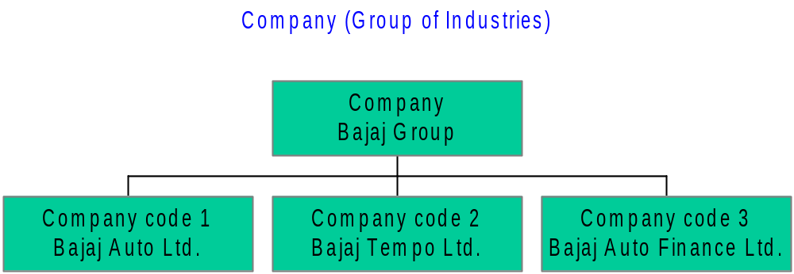
Company
- Smallest organizational unit for which
individual financial statements can be
drawn up according to the relevant
commercial law.
- A company can consist of one or more
company codes.

Slide 5
Company Code
The smallest organizational unit for which a complete self-contained set of accounts can be drawn up for purposes of external reporting (Balance sheet, Profit & Loss A/c statement).
Business Area
Organizational unit of financial accounting that represents a separate area of operations or responsibilities within an organization and to
which value changes recorded in Financial Accounting can be allocated.
Business areas are used in external segment reporting (over and above company codes) based on the significant areas of operation (for example,product lines) of a business enterprise. A segment is an isolated area of activity.

Slide 6
Financial Accounting Global Settings
This area contains configuration of –
- Fiscal year variant
- Posting period variant
- Document Number ranges
- Document types
- Field status variant

Slide 7
Fiscal Year Variant
This variant is going to define the maximum number of periods (months) allowed in the fiscal year and special periods (for adjustment/closing) entries.
This allows to specify whether to follow calendar year or not.

Slide 8
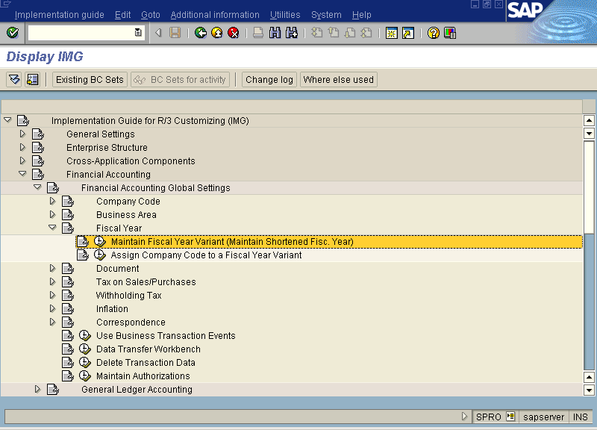

Slide 9
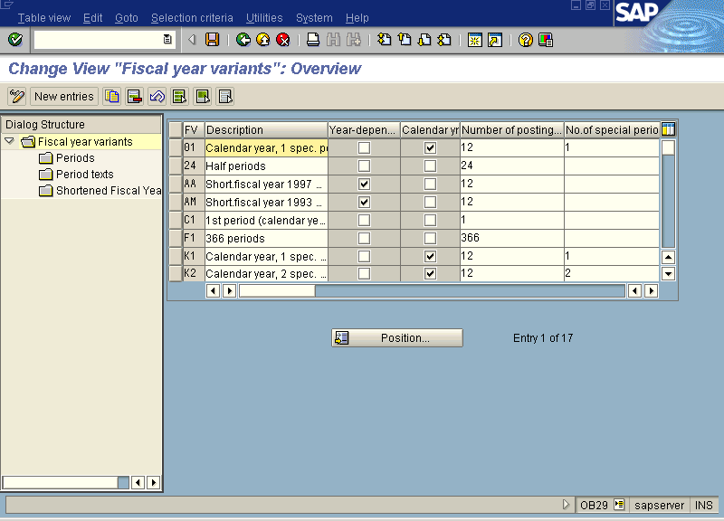

Slide 10
Posting period variant
Posting period variant allows you to open/close any period for a year. You can set extra controls by restricting for range of accounts (for particular Account Type) for the said period.

Slide 11
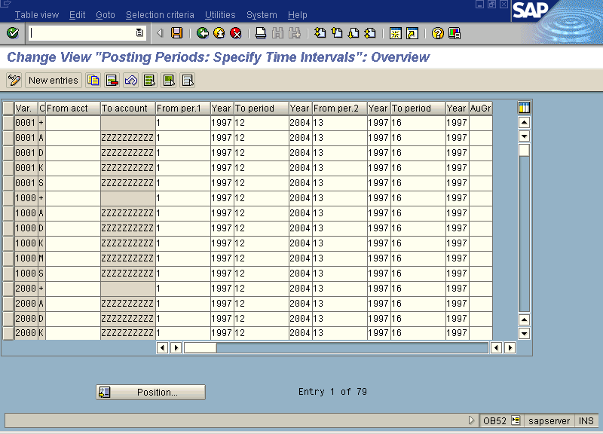

Slide 12
Document Number Range Intervals
These ranges are used for saving an entry with a particular number either maintained internally (system generated) or externally (given by the user or updated via other module).
Year specific number range can be maintained.

Slide 13
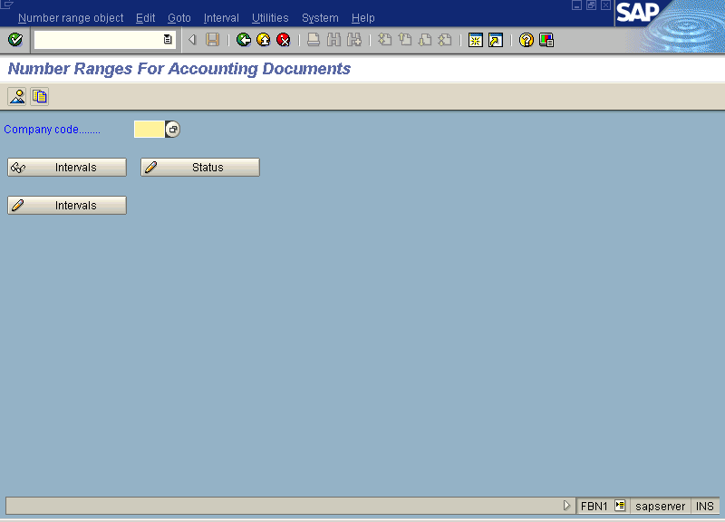

Slide 14
Document Types
The type of entry that is allowed in the system. This controls the account types, reversal document type, number range and so on.
These are used to identify the document entry in the system.
(Note : As far as possible do not make any changes in the existing one but if required create your own records.)

Slide 15
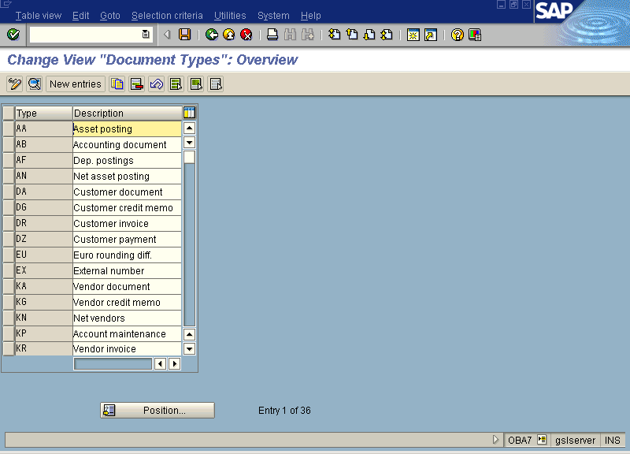

Slide 16
Posting keys
This is nothing but codification of ‘Debit or Credit’ indicator.
These codes allows you to identify whether you have debited or credited an account in a particular transaction.
(Note : As far as possible do not make changes to these settings, if required create your own records.)

Slide 17
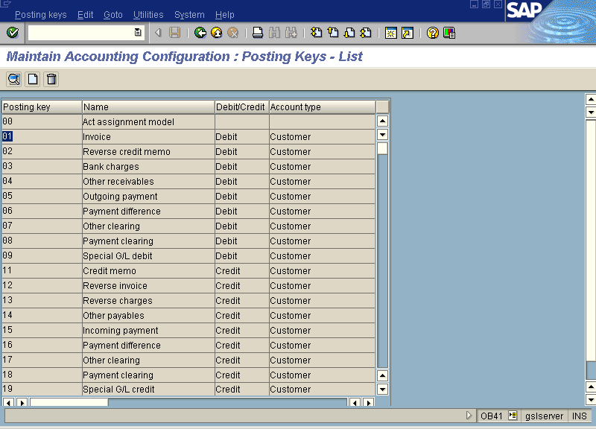

Slide 18
Field Status Variant
When any GL account is used at the document entry level then out of all available controls (fields) on the screen (template) which fields are to be keep as ‘Suppressed / Required / Optional’.
This variant will be activated at the time of entry in your company code for a specific GL account.

Slide 19
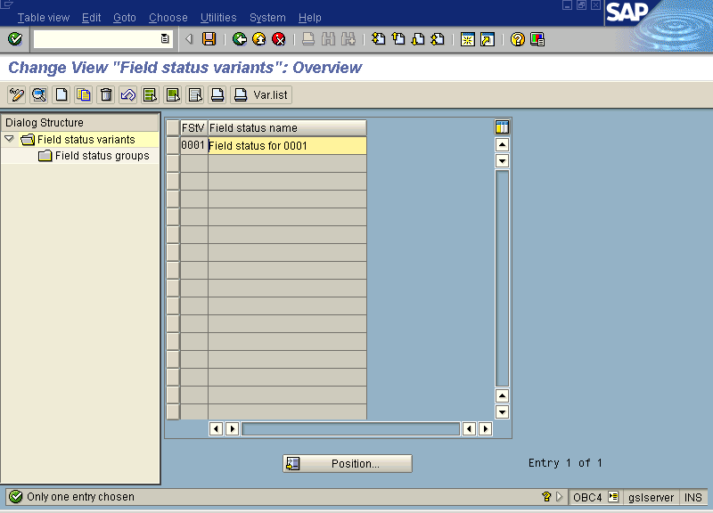

Slide 20
General Ledger Accounting
Being the main ledger, configuration of this must be done carefully. According to the business processes followed by the company, basic GL accounts other certain parameters to control them needs to be defined.
- Chart of Accounts
- Account Group
- Retained Earnings Account

Slide 21
Chart of Account
This is nothing but list of all GL accounts that are used in day to day activities.
This is summary of all GL accounts which are grouped together in different account group.
You can control –
- Length of GL account number
- Maintenance language

Slide 22
- Operating COA (Chart of Account)
- Group COA
- Country COA
These types of COA can be maintained.
One COA can be assigned to multiple company codes. But one company code can have only single COA (operating).

Slide 23
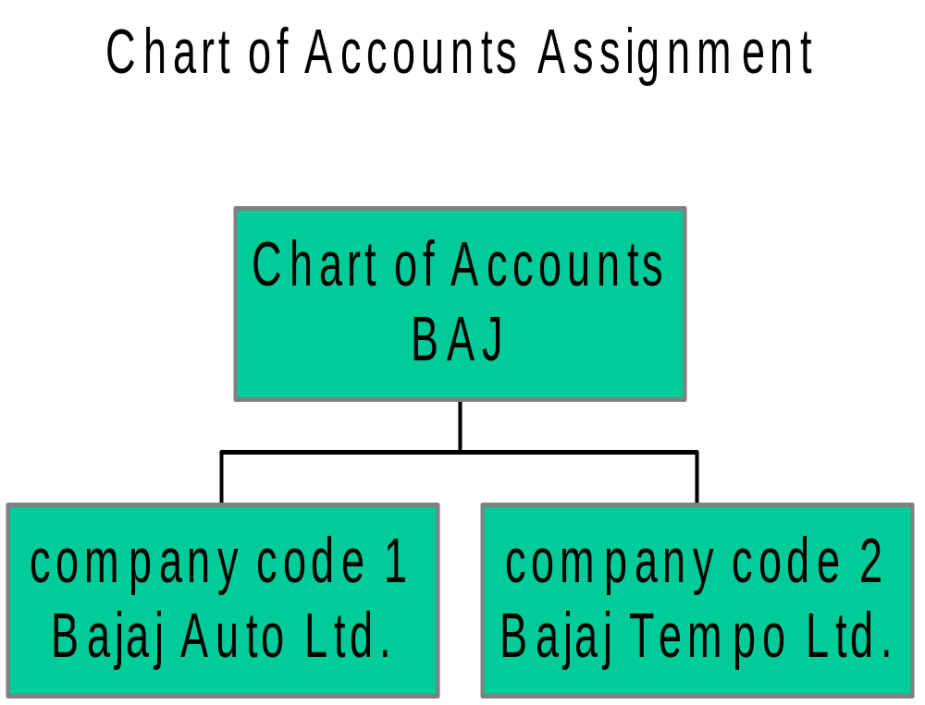

Slide 24
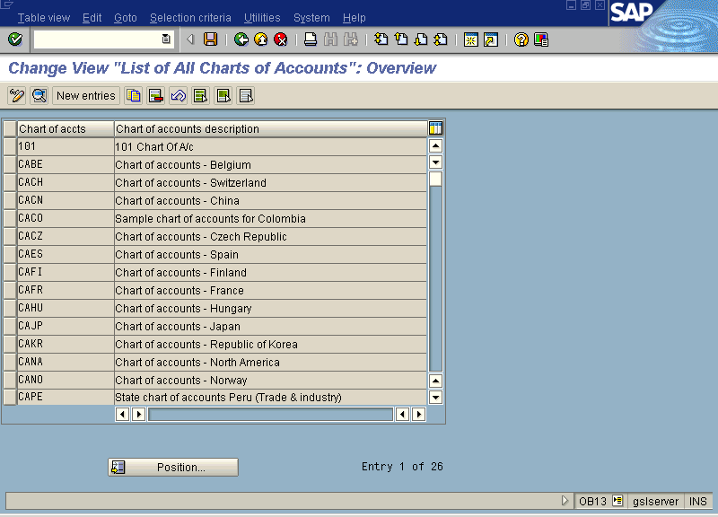

Slide 25
Account Group
All accounts from the COA are segregated in different groups according to their nature. For example, all assets can be grouped together into fixed or current assets.
Here you set the numbering system to be followed while GL master record will be created and company code level parameters according to the requirement.

Slide 26
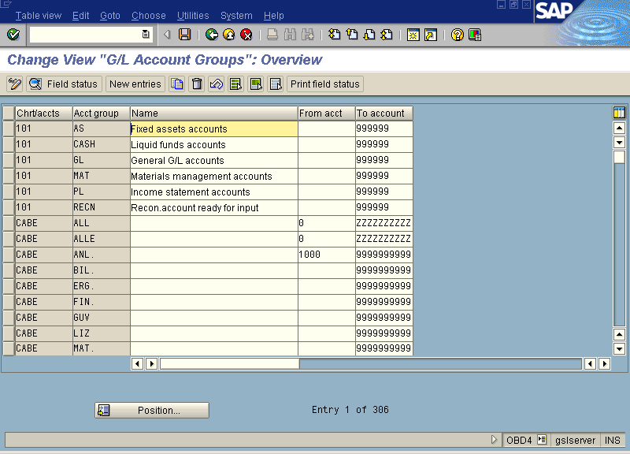

Slide 27
Retained Earnings Account
Each accounts from P &L needs to be linked to retained earnings account in the COA. Special program is used to transfer the balances to this account at the year end processing (balance carry forward).
Each P&L account is assigned to a retained earnings account via a key. You need to provide this key in the P & L statement type.

Slide 28
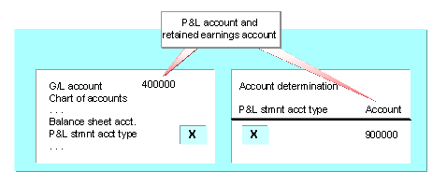

Slide 29
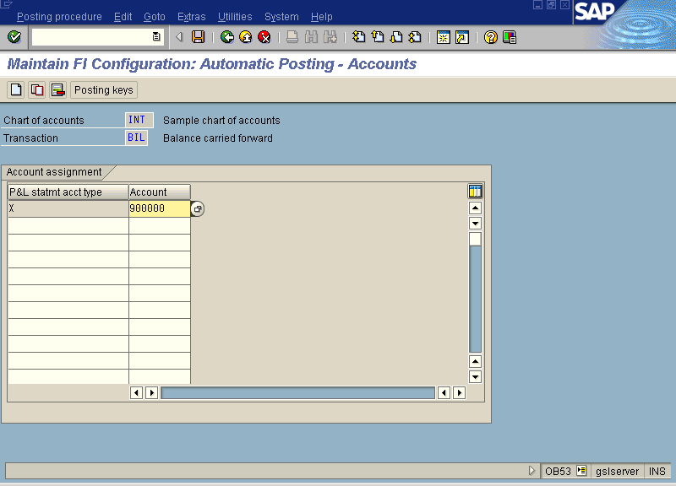

Slide 30
GL Master Record
The GL account is defined at two levels –
- COA
- Company code
Separate screens are available to define the account, and single screen which allows you to maintain the full details (also called as central definition) is also available.

Slide 31
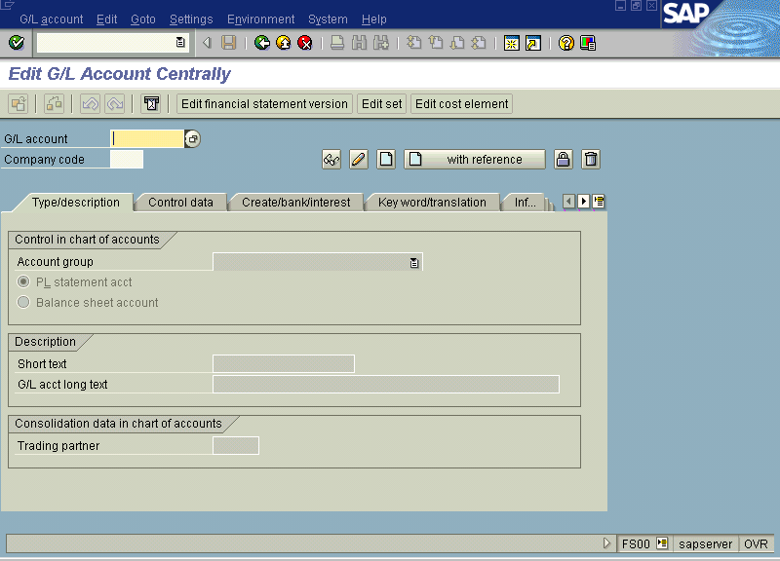

Slide 32
GL account posting
There are many posting screens that can be used which allows you to use different templates.
For example FB50,FV50, F-65,F-02 and many others.
They are used to post JVs or adjustment entries.

Slide 33
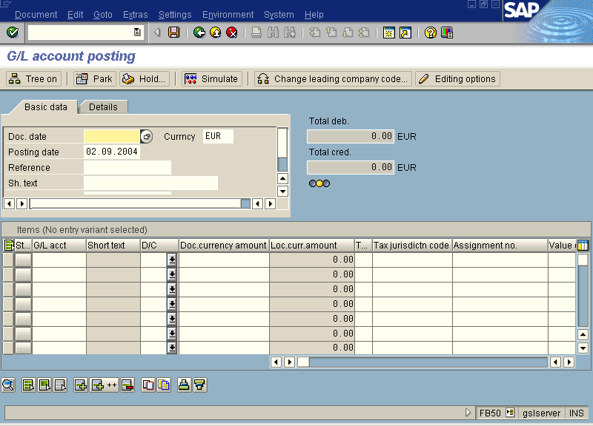

Slide 34
Temporary Savings
Parking of Documents
Before posting
- System generates number.
After posting
- Parked doc. gets the same number as earlier
Holding of Documents
Before posting
- User has to give the name / number to the document
After posting
- Held doc. gets deleted and number will be generated by the system.
At this level both documents can be modified and even can be deleted. But no account gets updated and are not available for evaluation.

Slide 35
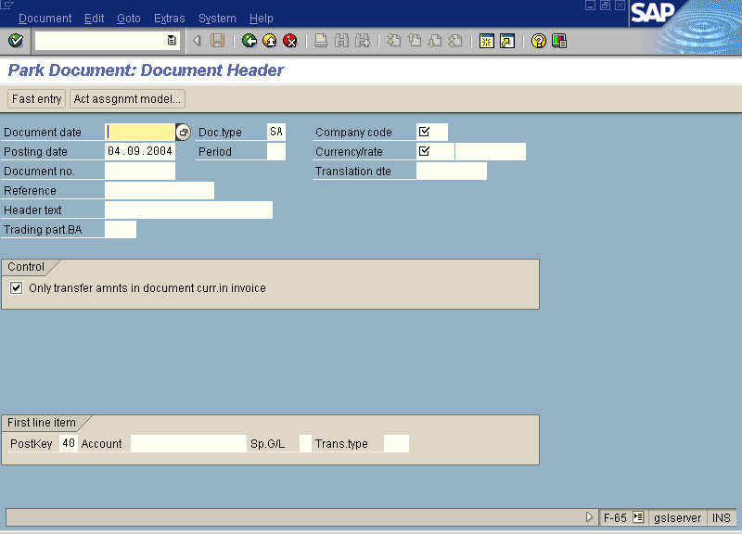

Slide 36
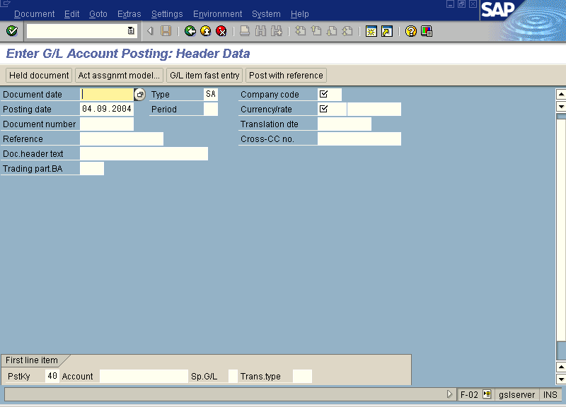

Slide 37
Reference Documents
You can post documents by giving reference to earlier posted documents or even calling a template with default line items which can be changed, added, deleted at the time of actual posting.
Account assignment model
- A template with default line items can be created and can be called for any number of times.
- To update the document you need to ‘Post’ explicitly.

Slide 38
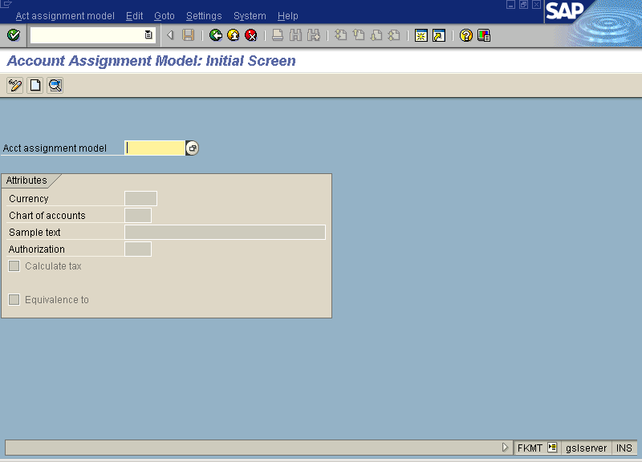

Slide 39
Reports
Various predefined reports are available in the system which we use very often.
GL account balances, document list, line item wise display, Balance sheet and Profit & Loss statements, account master record list and many more.
For customize reports functional person (even end user) can create reports by using tools provided by SAP or can take help of ABAP programmers.

Slide 40
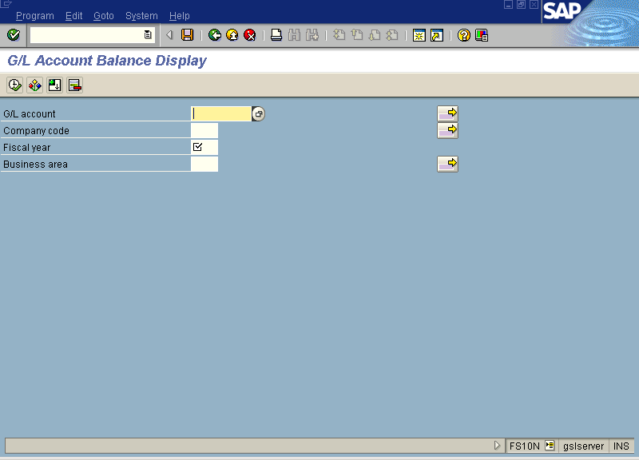

Slide 41
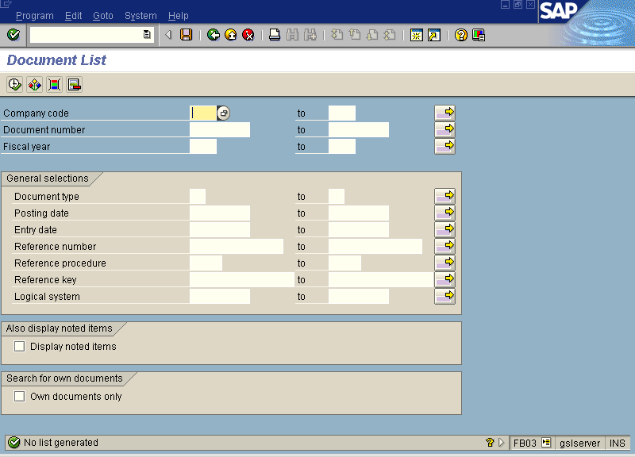

Slide 42
